Slide 1
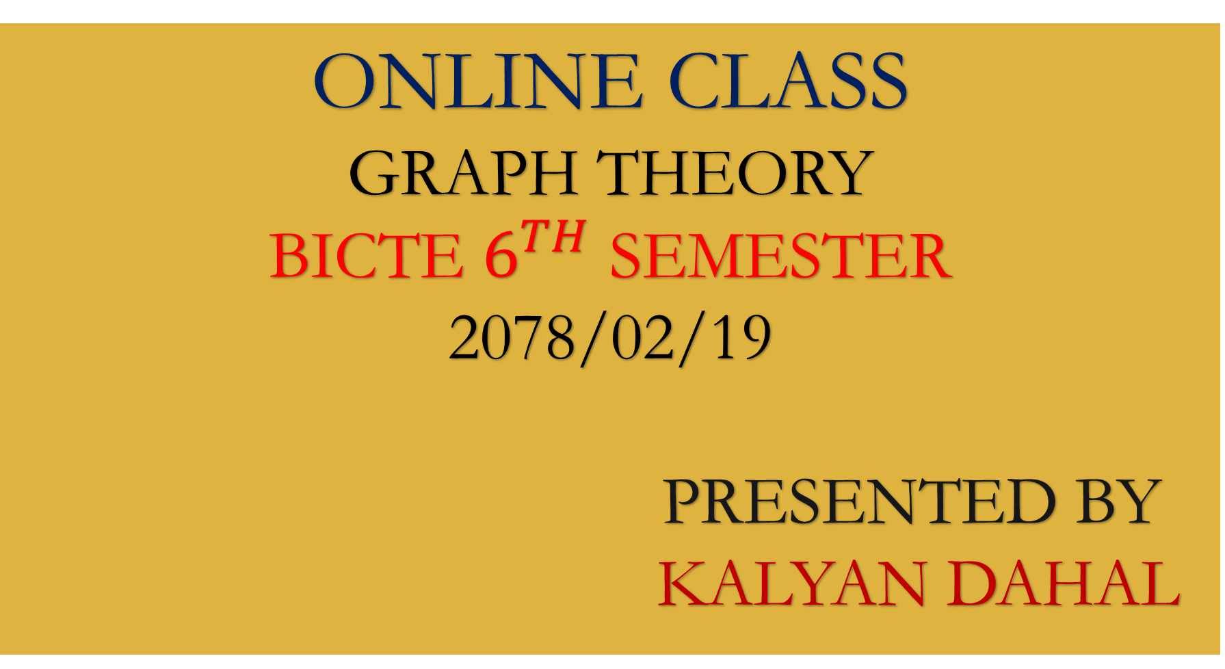
ONLINE CLASS
GRAPH THEORY
BICTE $6^{TH}$ SEMESTER
2078/02/19
PRESENTED BY KALYAN DAHAL

Slide 2
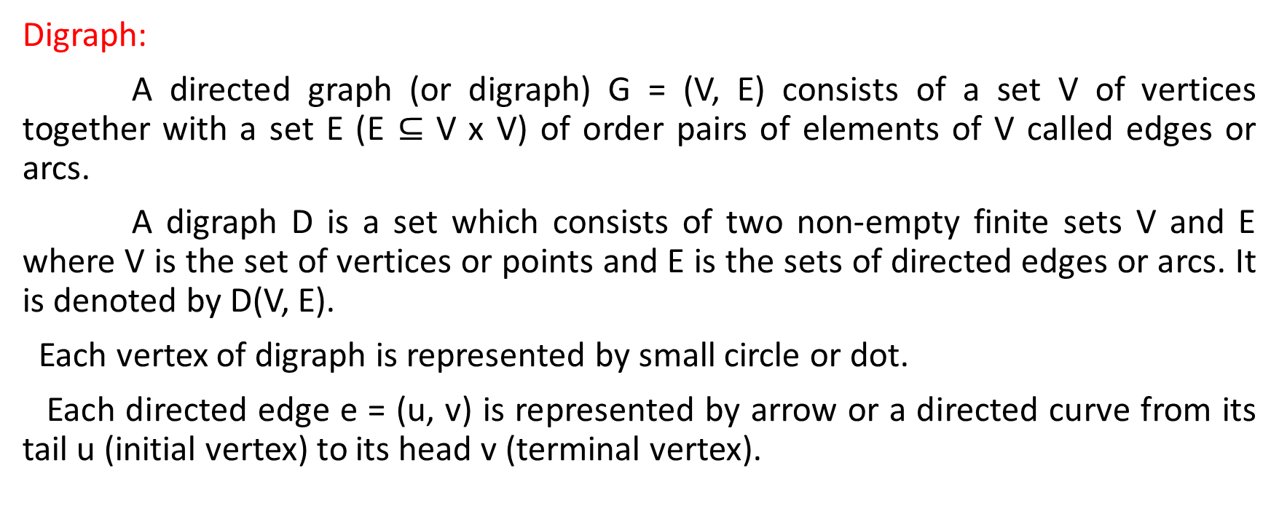
Digraph and Traversability
Digraph:
A directed graph (or digraph) G = (V, E) consists of a set V of vertices together with a set E (E $⊆$ V x V) of order pairs of elements of V called edges or arcs.
A digraph D is a set which consists of two non-empty finite sets V and E where V is the set of vertices or points and E is the sets of directed edges or arcs. It is denoted by D(V, E).
Each vertex of digraph is represented by small circle or dot.
Each directed edge e = (u, v) is represented by arrow or a directed curve from its tail u (initial vertex) to its head v (terminal vertex).
u
v

Slide 3
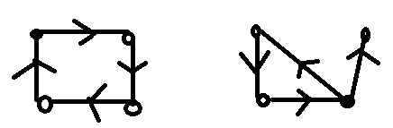
Note: The directed edge e is called ‘incident out’ of initial vertex and ‘incident into’ of the terminal vertex.
Pictorial representation of digraph:
The diagraph G = (V, E) and H = (V, E) is given below.
Here, the digraph G = (V, E) Where V = {a, b, c, d} and edge E = {(a, b), (b, c), (c, d), (d, a)} and diagraph H = (V, E) where vertex V = {a, b, c, d} and edge E = {(a, b), (b, c), (c, a), (c, d)}.
a
a
b
d
G
H
c
b
d
c

Slide 4
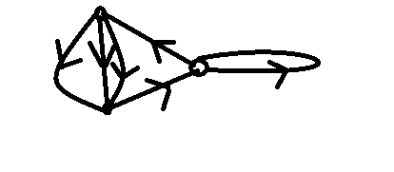






Loops and parallel arcs
Self-loop or loop:
an arc or edge with same initial and terminal vertex is called a self-loop or loop.
Parallel arcs:
Two arcs in a diagraph are said to be parallel or multiple directed arcs if they have same initial and terminal vertices.
b
$$e_{2}$$
$$e_{6}$$
$$e_{5}$$
$$e_{1}$$
$$e_{4}$$
a
c
$$e_{3}$$

Slide 5
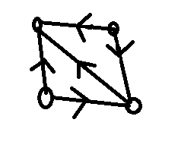
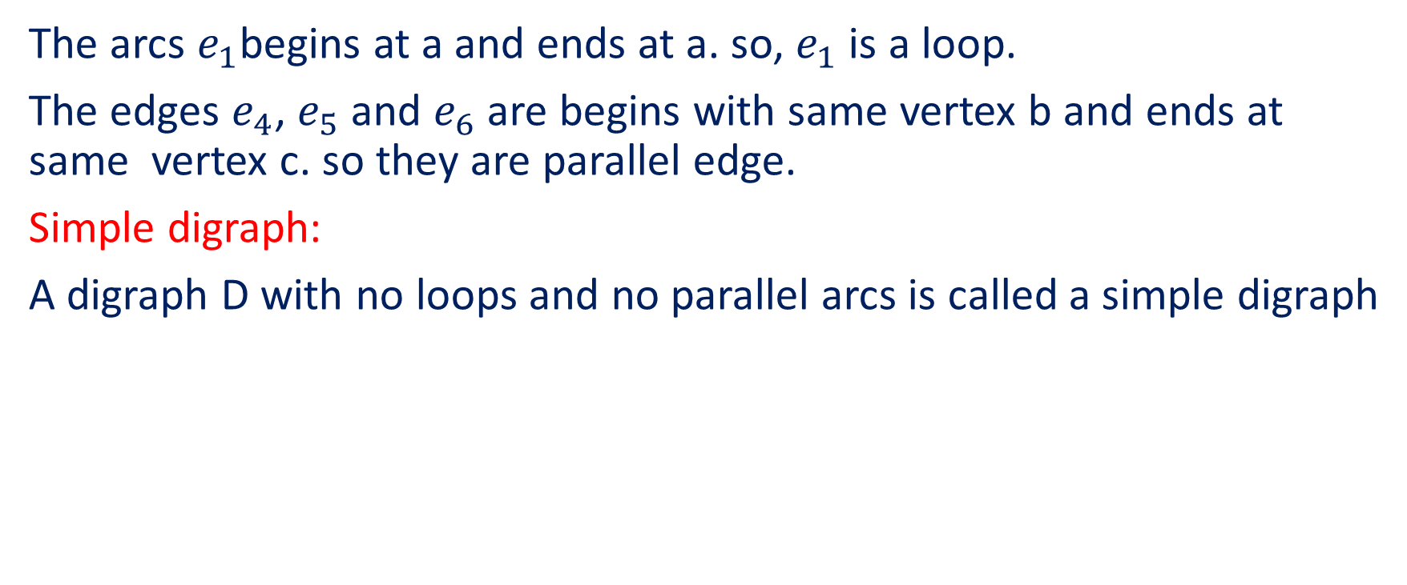
Continued…..
The arcs $e_{1}$begins at a and ends at a. so, $e_{1}$ is a loop.
The edges $e_{4}$, $e_{5}$ and $e_{6}$ are begins with same vertex b and ends at same vertex c. so they are parallel edge.
Simple digraph:
A digraph D with no loops and no parallel arcs is called a simple digraph
Simple diagraph

Slide 6
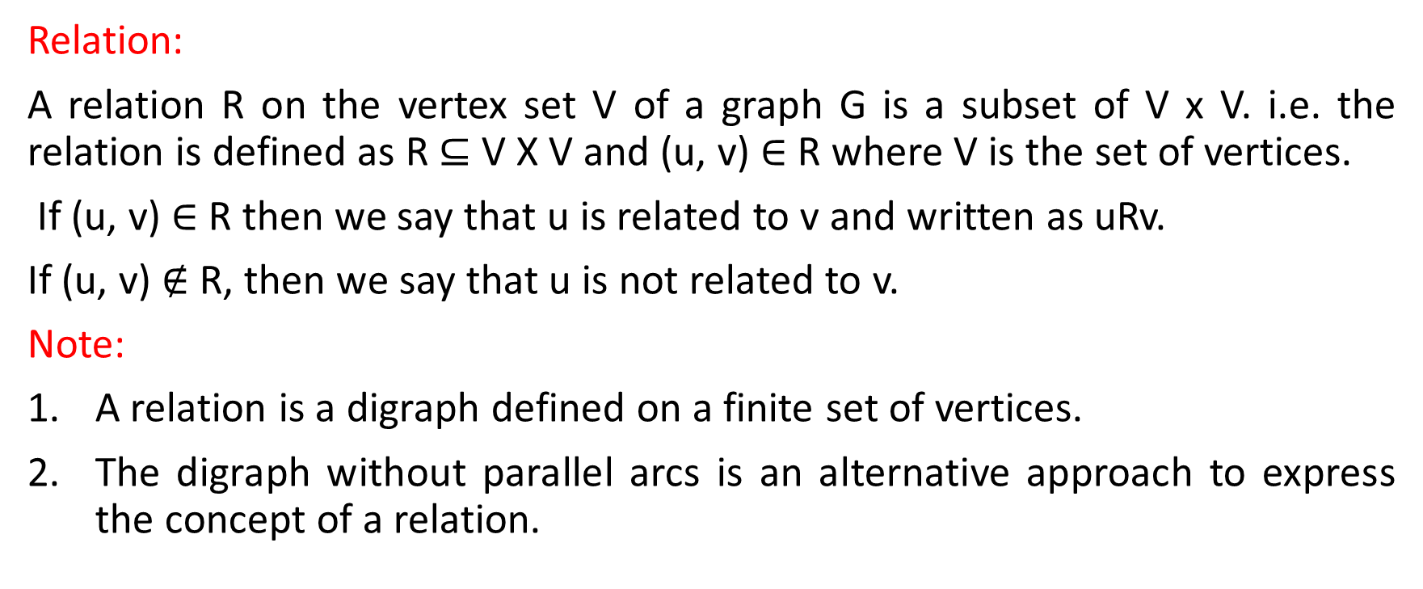
Relation
Relation:
A relation R on the vertex set V of a graph G is a subset of V x V. i.e. the relation is defined as R $⊆$ V X V and (u, v) $∈$ R where V is the set of vertices.
If (u, v) $∈$ R then we say that u is related to v and written as uRv.
If (u, v) $∉$ R, then we say that u is not related to v.
Note:
A relation is a digraph defined on a finite set of vertices.
The digraph without parallel arcs is an alternative approach to express the concept of a relation.

Slide 7
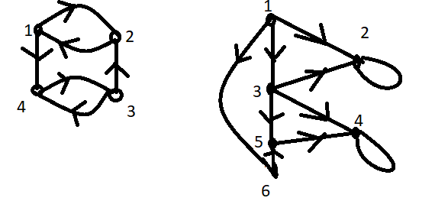
Continued…..
3. The two concepts such as the digraphs without parallel arcs and relation on a finite set are the identical concepts in digraphs.
From figure I, V = {1, 2, 3, 4}
R = {(1, 2), (2, 1), (1, 4), (3, 2), (3, 4), (4, 3)}
I
II

Slide 8
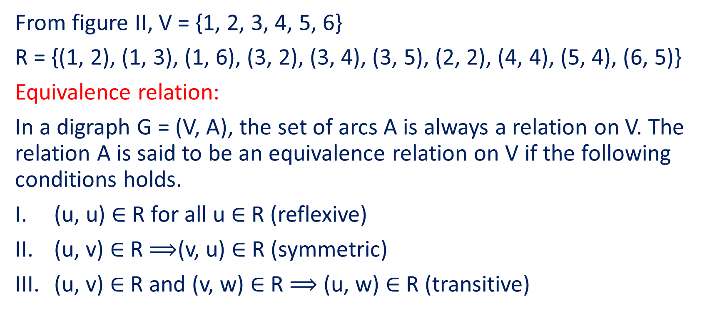
Continued…..
From figure II, V = {1, 2, 3, 4, 5, 6}
R = {(1, 2), (1, 3), (1, 6), (3, 2), (3, 4), (3, 5), (2, 2), (4, 4), (5, 4), (6, 5)}
Equivalence relation:
In a digraph G = (V, A), the set of arcs A is always a relation on V. The relation A is said to be an equivalence relation on V if the following conditions holds.
(u, u) $∈$ R for all u $∈$ R (reflexive)
(u, v) $∈$ R $⟹$(v, u) $∈$ R (symmetric)
(u, v) $∈$ R and (v, w) $∈$ R $⟹$ (u, w) $∈$ R (transitive)

Slide 9
Continued…..
Note:
The relation must satisfy all of above three relation to be an equivalence relation.
The digraph G = (V, E) is called reflexive or symmetric or transitive if R is reflexive or symmetric or transitive respectively.
The digraph representing an equivalence relation is said to be an equivalent digraph.

Slide 10
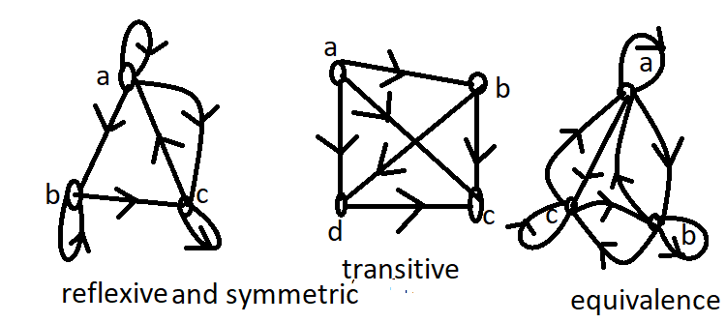
Continued…..
Figure of reflexive, symmetric, transitive and equivalence relation:

Slide 11
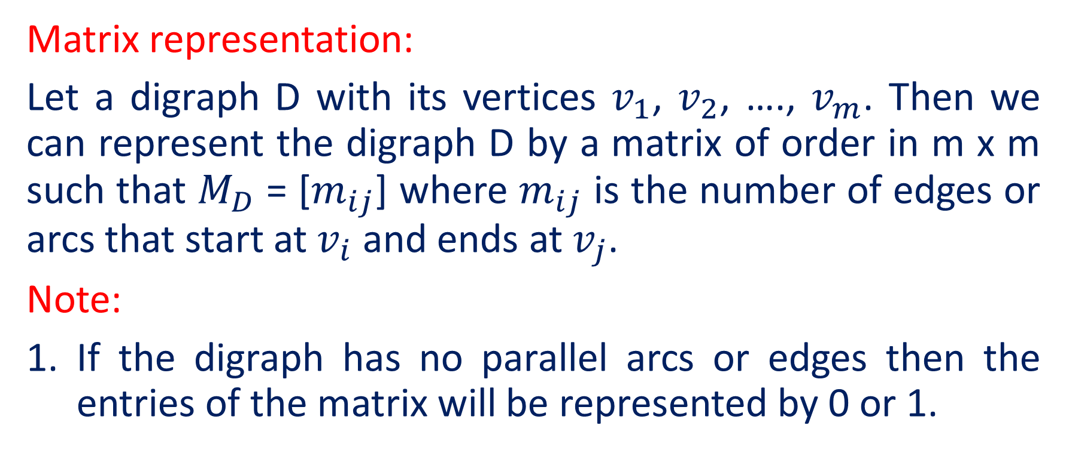
Matrix representation
Matrix representation:
Let a digraph D with its vertices $v_{1}$, $v_{2}$, …., $v_{m}$. Then we can represent the digraph D by a matrix of order in m x m such that $M_{D}$ = [$m_{ij}$] where $m_{ij}$ is the number of edges or arcs that start at $v_{i}$ and ends at $v_{j}$.
Note:
If the digraph has no parallel arcs or edges then the entries of the matrix will be represented by 0 or 1.

Slide 12
Continued….
2. If there are parallel arcs or edges then they will be represented by the number as per their number of repetition. Eg. If there is 3 parallel arcs then they will be represented by 3.
3. The matrix representation of given digraph is done by the square matrix.
4. Digraph is a graphical representation of a relation among the vertices.

Slide 13
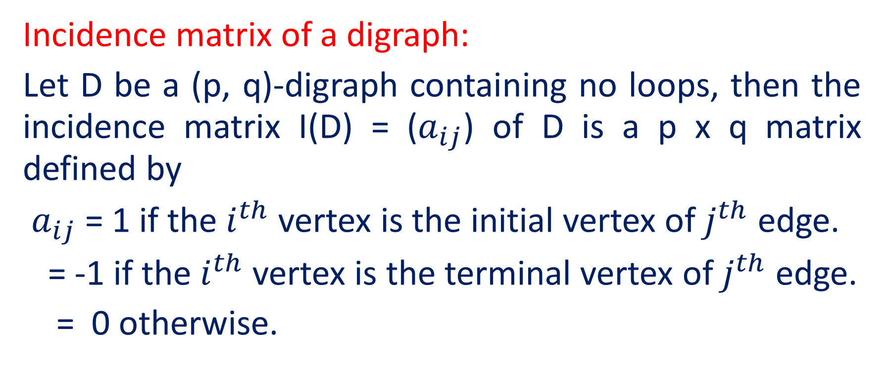
Continued….
Incidence matrix of a digraph:
Let D be a (p, q)-digraph containing no loops, then the incidence matrix I(D) = ($a_{ij}$) of D is a p x q matrix defined by
$a_{ij}$ = 1 if the $i^{th}$ vertex is the initial vertex of $j^{th}$ edge.
= -1 if the $i^{th}$ vertex is the terminal vertex of $j^{th}$ edge.
= 0 otherwise.

Slide 14
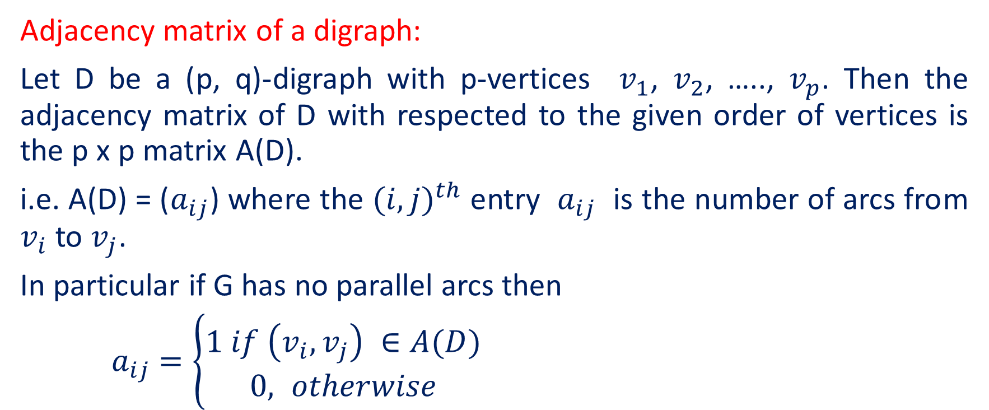
Continued….
Adjacency matrix of a digraph:
Let D be a (p, q)-digraph with p-vertices $v_{1}$, $v_{2}$, ….., $v_{p}$. Then the adjacency matrix of D with respected to the given order of vertices is the p x p matrix A(D).
i.e. A(D) = ($a_{ij}$) where the ${(i, j)}^{th}$ entry $a_{ij}$ is the number of arcs from $v_{i}$ to $v_{j}$.
In particular if G has no parallel arcs then
$a_{ij}$ $=\left\{\begin{aligned}1 if \left(v_{i},v_{j}\right) ∈A(D) \\ 0, otherwise\end{aligned}\right.$

Slide 15
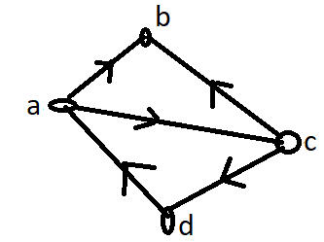
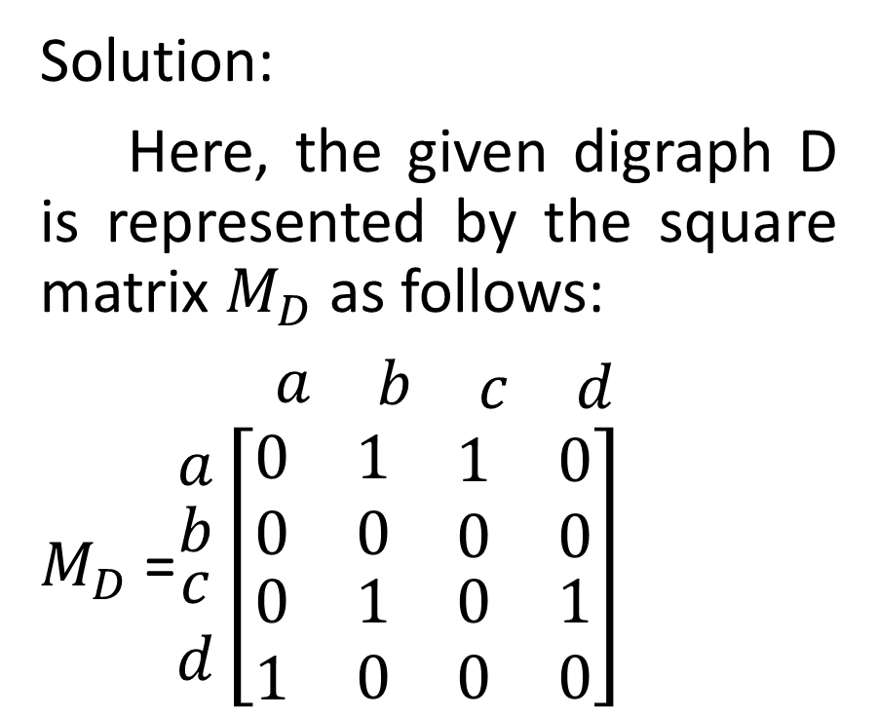
Represented the given digraph by matrix.
Solution:
Here, the given digraph D is represented by the square matrix $M_{D}$ as follows:
$\begin{matrix}a & \begin{matrix}b & \begin{matrix}c & d\end{matrix}\end{matrix}\end{matrix}$
$M_{D}$ =$\begin{matrix}a \\ \begin{matrix}b \\ \begin{matrix}c \\ d\end{matrix}\end{matrix}\end{matrix}\left[\begin{matrix}0 & 1 & \begin{matrix}1 & 0\end{matrix} \\ 0 & 0 & \begin{matrix}0 & 0\end{matrix} \\ \begin{matrix}0 \\ 1\end{matrix} & \begin{matrix}1 \\ 0\end{matrix} & \begin{matrix}\begin{matrix}0 & 1\end{matrix} \\ \begin{matrix}0 & 0\end{matrix}\end{matrix}\end{matrix}\right]$

Slide 16
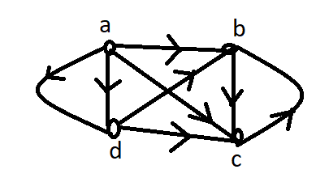
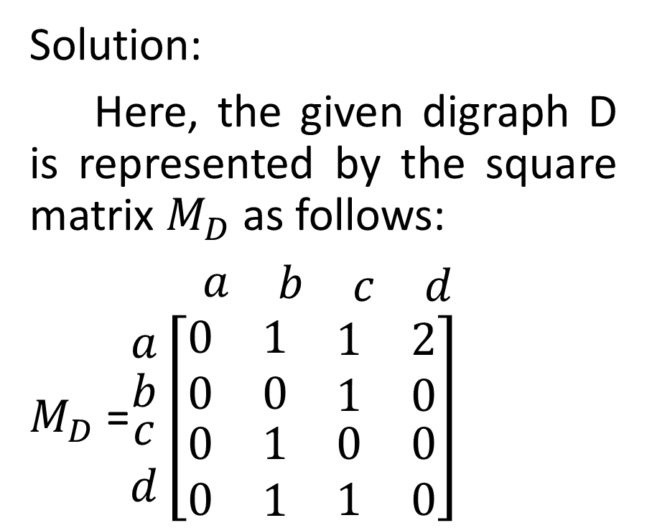
Represented the digraph with adjacency matrix.
Solution:
Here, the given digraph D is represented by the square matrix $M_{D}$ as follows:
$\begin{matrix}a & \begin{matrix}b & \begin{matrix}c & d\end{matrix}\end{matrix}\end{matrix}$
$M_{D}$ =$\begin{matrix}a \\ \begin{matrix}b \\ \begin{matrix}c \\ d\end{matrix}\end{matrix}\end{matrix}\left[\begin{matrix}0 & 1 & \begin{matrix}1 & 2\end{matrix} \\ 0 & 0 & \begin{matrix}1 & 0\end{matrix} \\ \begin{matrix}0 \\ 0\end{matrix} & \begin{matrix}1 \\ 1\end{matrix} & \begin{matrix}\begin{matrix}0 & 0\end{matrix} \\ \begin{matrix}1 & 0\end{matrix}\end{matrix}\end{matrix}\right]$

Slide 17
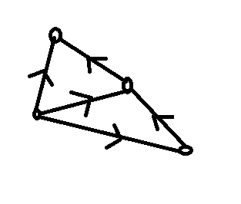



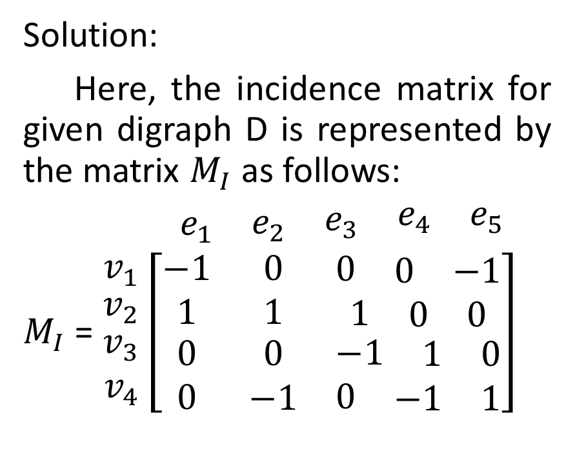






Find the incidence matrix of the given the digraph.
$$v_{1}$$
Solution:
Here, the incidence matrix for given digraph D is represented by the matrix $M_{I}$ as follows:
$\begin{matrix}e_{1} & \begin{matrix}e_{2} & \begin{matrix}e_{3} & \begin{matrix}e_{4} & e_{5}\end{matrix}\end{matrix}\end{matrix}\end{matrix}$
$M_{I}$ = $\begin{matrix}v_{1} \\ \begin{matrix}v_{2} \\ \begin{matrix}v_{3} \\ v_{4}\end{matrix}\end{matrix}\end{matrix}\left[\begin{matrix}−1 & 0 & \begin{matrix}0 & \begin{matrix}0 & −1\end{matrix}\end{matrix} \\ 1 & 1 & \begin{matrix}1 & \begin{matrix}0 & 0\end{matrix}\end{matrix} \\ \begin{matrix}0 \\ 0\end{matrix} & \begin{matrix}0 \\ −1\end{matrix} & \begin{matrix}\begin{matrix}−1 & \begin{matrix}1 & 0\end{matrix}\end{matrix} \\ \begin{matrix}0 & \begin{matrix}−1 & 1\end{matrix}\end{matrix}\end{matrix}\end{matrix}\right]$
$$e_{5}$$
$$e_{1}$$
$$v_{4}$$
$$e_{2}$$
$$e_{4}$$
$$v_{2}$$
$$e_{3}$$
$$v_{3}$$

Slide 18


